Slide 1
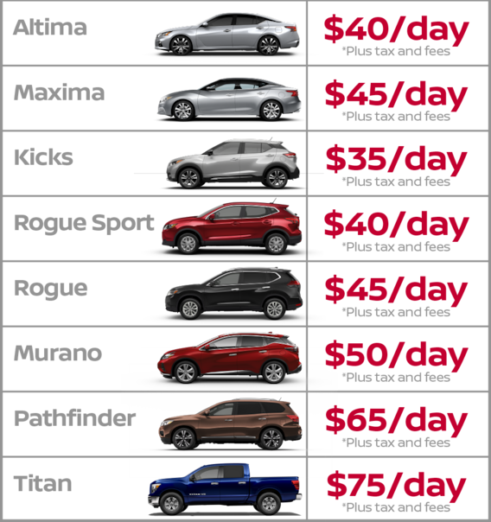
Rental Car
Member of group:
CE130353 - Nguyễn Minh Thảo
CE130377 - Nguyễn Thành Nhân
CE130252 - Nguyễn Chí Linh
CE130364 - Cao Văn Kha
CE130213 - Dương Trọng Nhân

Slide 2

Table of Content
1
Introduction about application
2
Sitemap
3
Introduction about tool
4
Demo

Slide 3
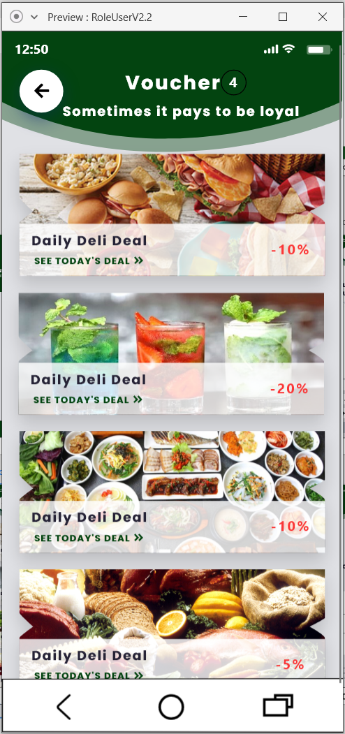
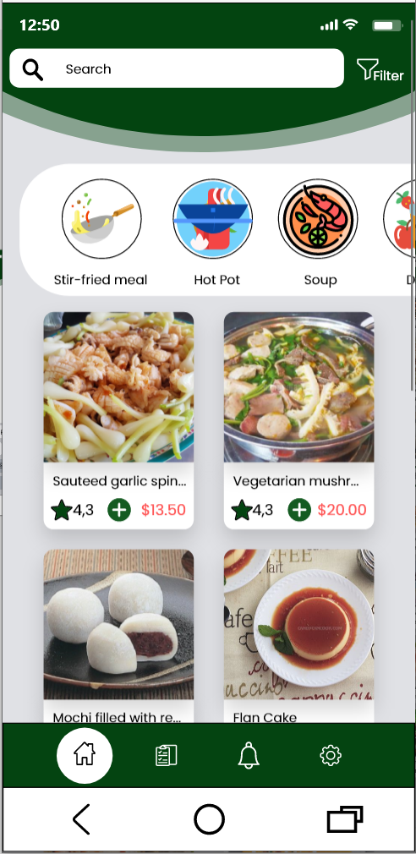
Application
1. What?
It’s a order food application and a website manage food, employee…
2. How?
For client: every one can order food and table at our restaurant.
For restaurant owner: we can manage food, employee, client, analysis revenue.

Slide 4
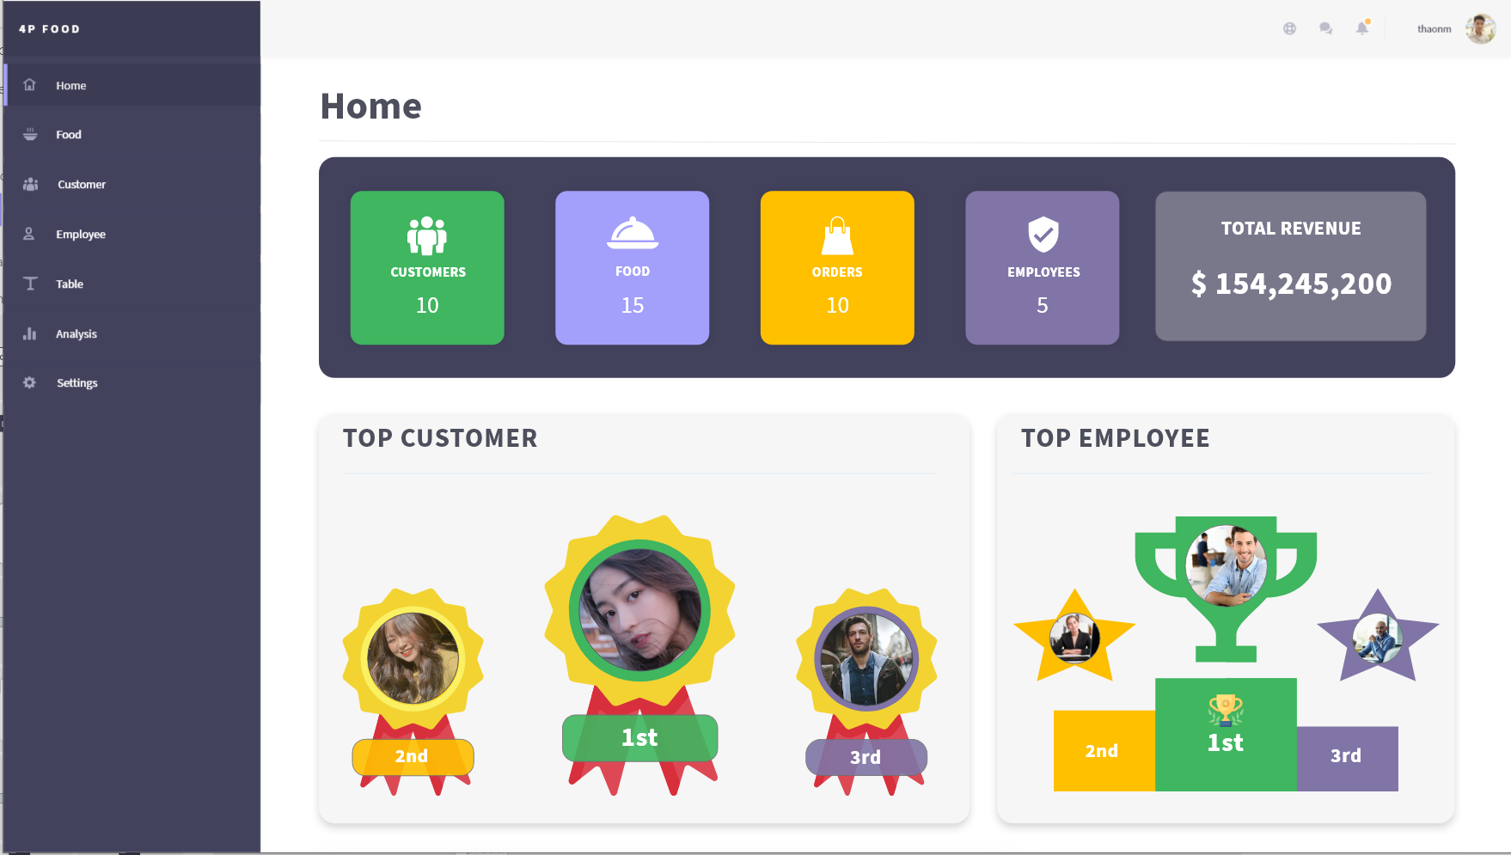
Application
2. Why?
For client:
The best place to meeting friends, boss, girl friend.
Avoid full tables when you walk into restaurant.
For restaurant owner:
Can manage employee, customer easily.
Analysis revenue. From which we can develop and improve pros and cons.

Slide 5
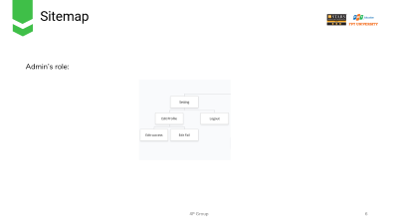
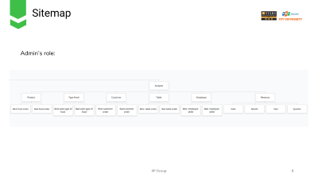
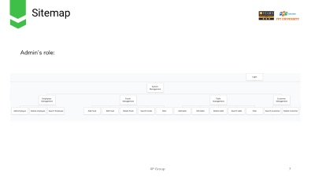
Sitemap
Admin’s role:
Setting
Management
Analysis

Slide 6
Sitemap
Admin’s role:

Slide 7
Sitemap
Admin’s role:

Slide 8
Sitemap
Admin’s role:

Slide 9
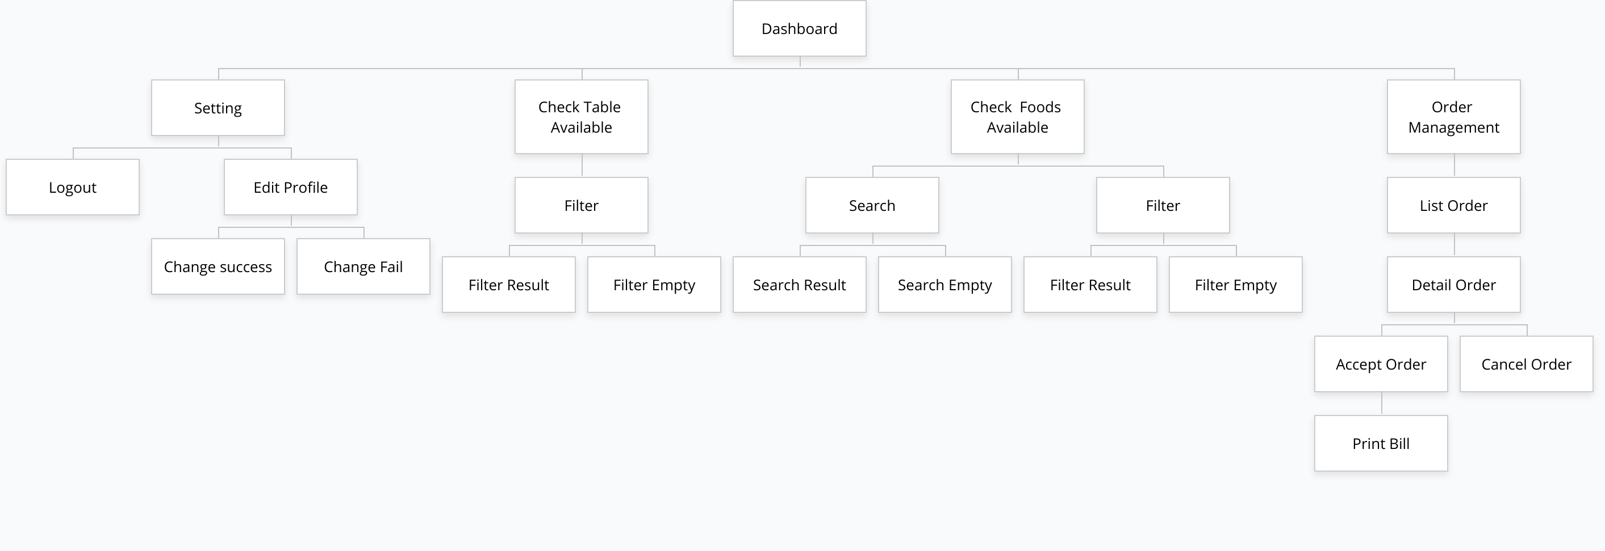
Sitemap
Employee’s role:

Slide 10
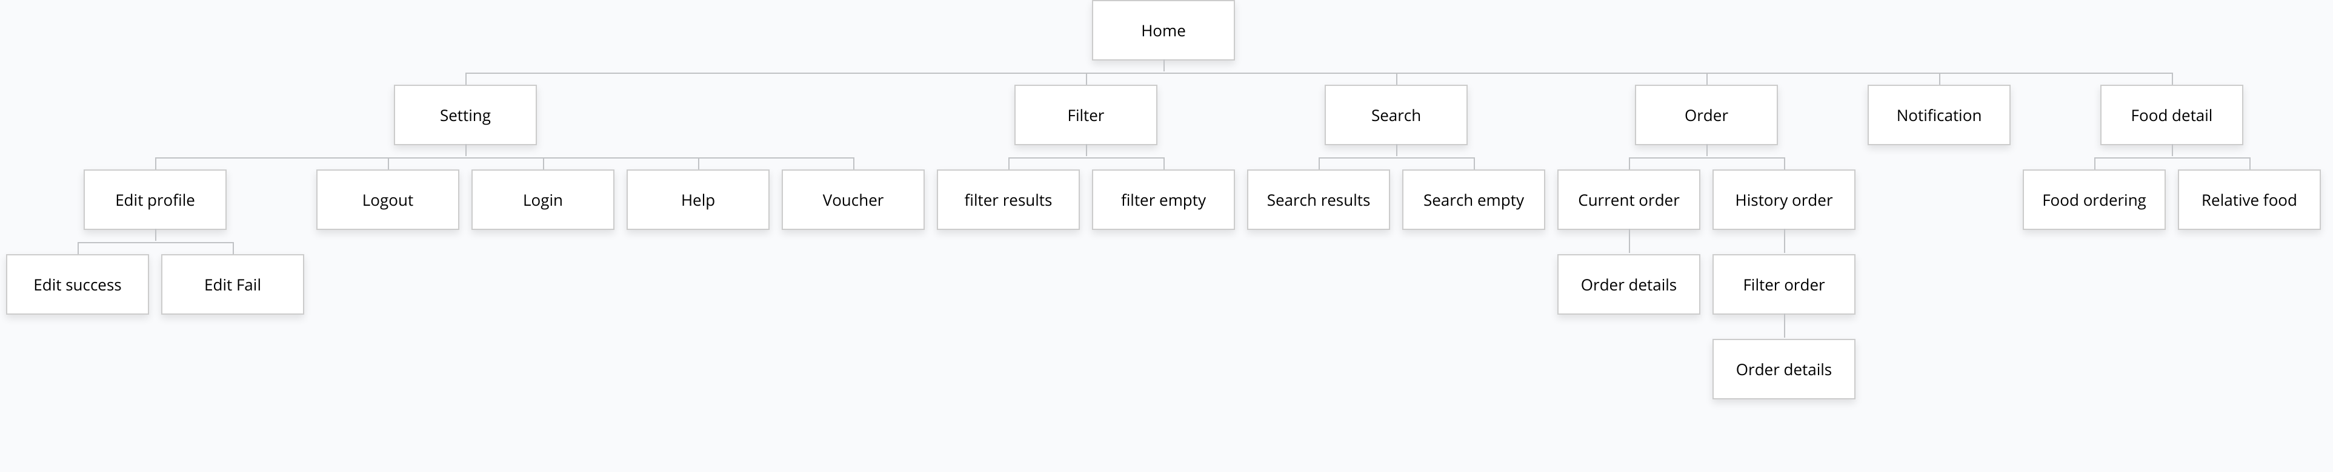
Sitemap
Client’s role:

Slide 11
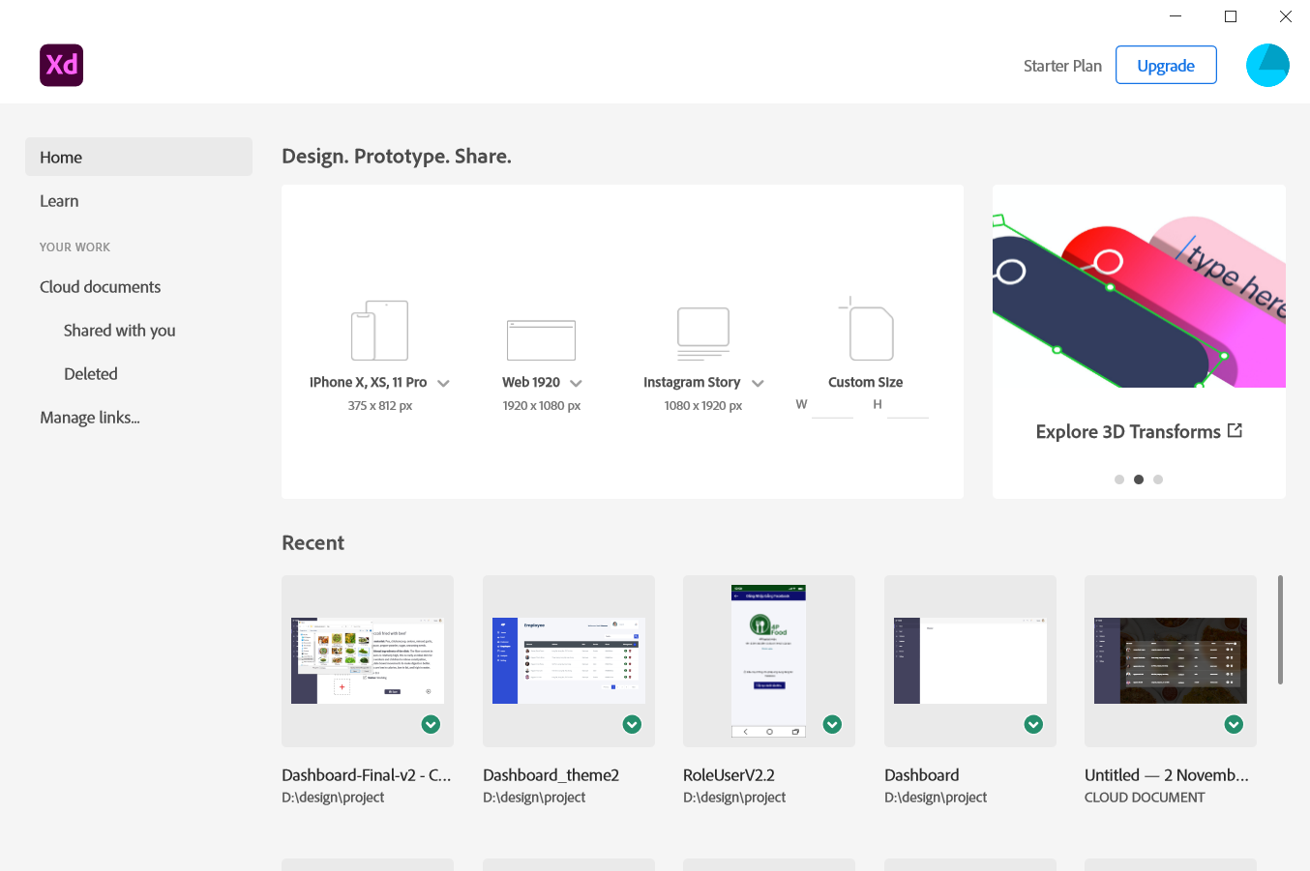
Tool
Recent file

Slide 12
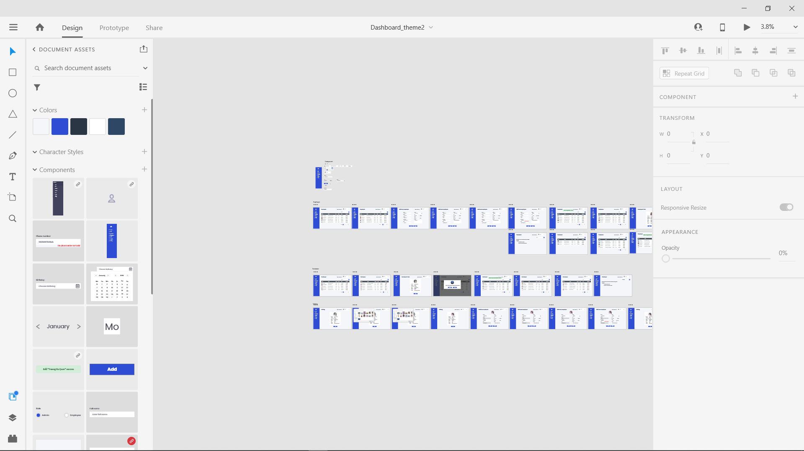
Tool
Design
Prototype
Working area
Tool
Attributes
Components
Layers

Slide 13
Demo

